Slide 1



City 311 Service Requests Analysis & Automation Dashboard
Datawalkers Data Analyst Challenge – Dabot.ai
Presented by : Neharika Dara

Slide 2
Project Overview
Objective :
Analyze 150K+ city service requests (311 data) to uncover patterns in citizen issues, agency workloads, and response performance.
The goal is to improve service delivery, identify bottlenecks, and enhance transparency through automation.
Dataset Summary :
Source: City 311 Open Service Requests Dataset
Records After Cleaning: 150,244 cases
Time Range: Dec 2017 – Mar 2018
Attributes: 24 validated fields (e.g., Category, Agency, Neighborhood, Resolution Time)
Data Quality: 99 % mapped cases | 0 duplicates | Cleaned missing values (logic = –1 for open requests)
Tools & Approach :
Python → Data Cleaning & Validation
Power BI → Dashboard Visualization & Automation
DAX → KPIs & Time Calculations
Power Automate → Alert Integration

Slide 3


Key Insights from the Analysis
Request Volume & Trends
Over 150K service requests were recorded within 4 months.
Activity peaks in January and gradually declines toward March.
Most reports occur between 8 AM – 4 PM, indicating active working hours.
Citizen Behavior & Issue Types
The top concerns are Street & Sidewalk Cleaning, Homeless Concerns, and Illegal Dumping.
These three categories represent ~60 % of total complaints — showing public focus on sanitation and safety.
Agency Workload & Efficiency
DPW Ops Queue handles the highest number of cases (62K+), maintaining strong resolution efficiency.
DPH Homeless Outreach faces longer average times (~59 days), reflecting complex case types.

Slide 4
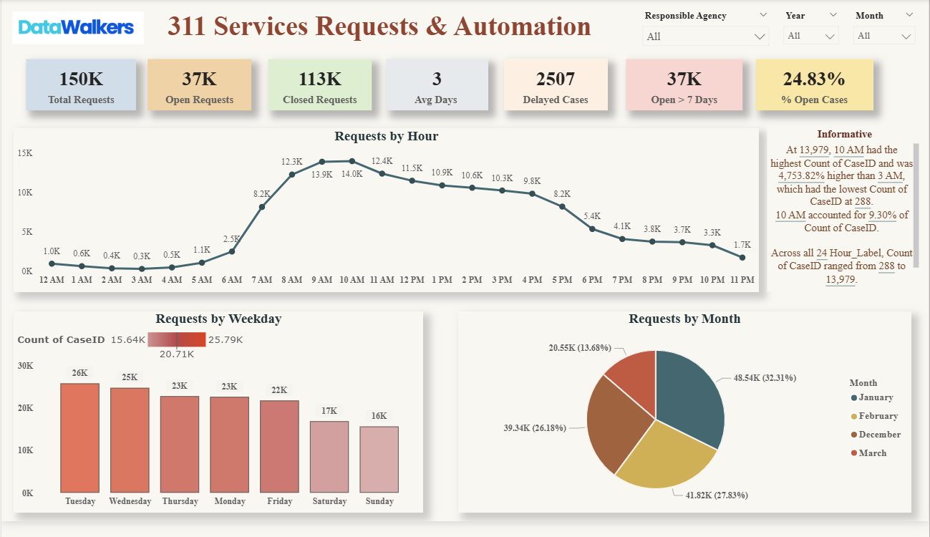
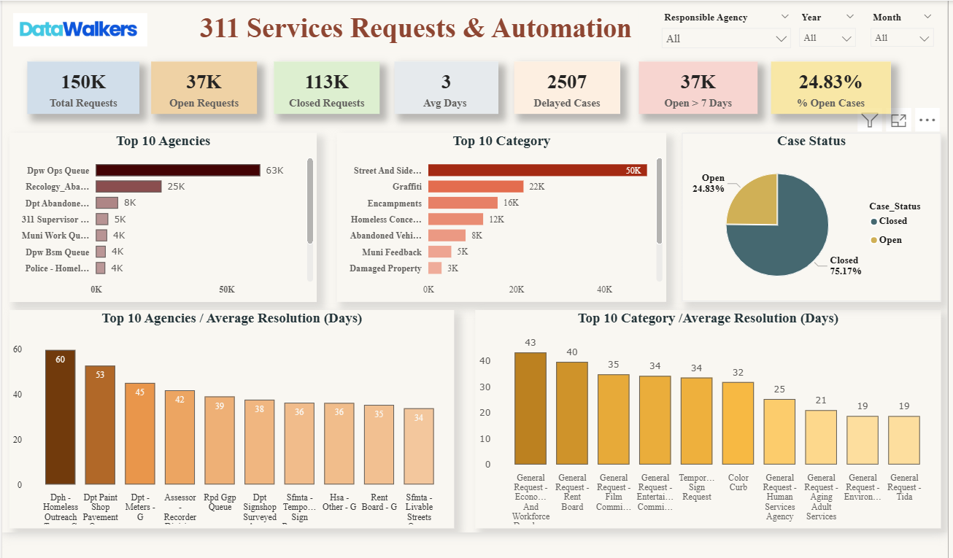
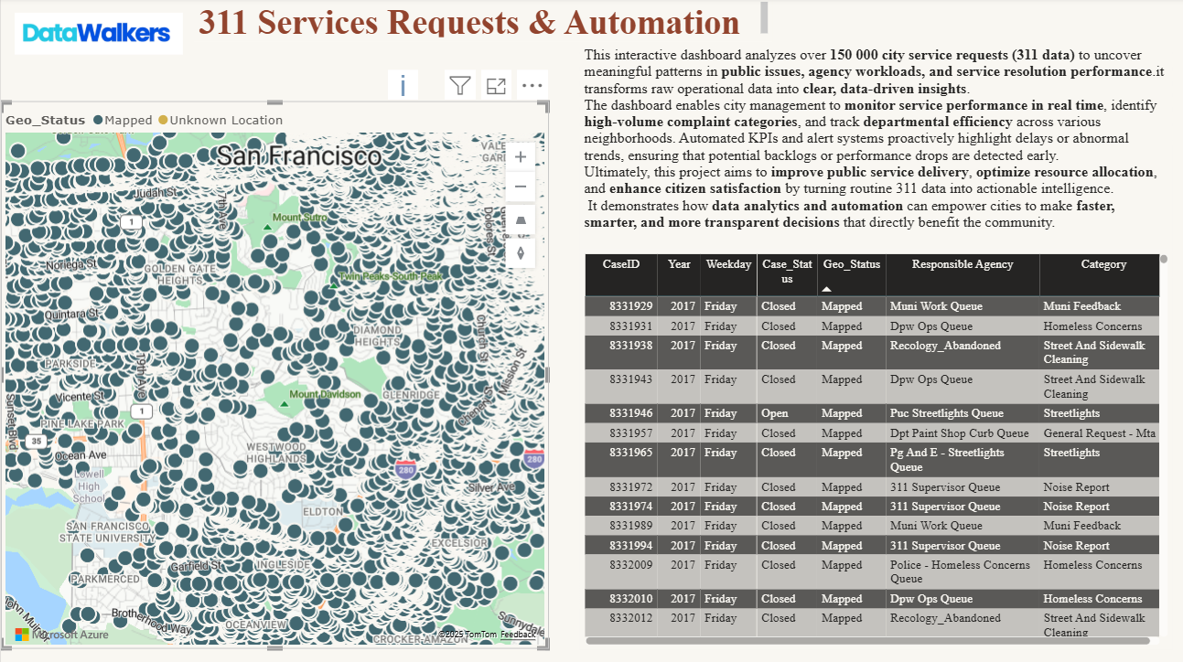
Power BI Dashboard Highlights
Visuals Displayed:
KPI Cards: Total Requests, Open Cases, Closed Cases, Avg Resolution (Days), Delayed Cases, Open >7 Days.
Trends: Request volume by Month, Weekday, and Hour.
Categorical Breakdown: By Responsible Agency and Category Type.
Geographical Mapping: 99 % of requests successfully mapped to Latitude/Longitude.
Insights in Action:
Monthly Trends: Peak in January indicates seasonal demand or increased reporting after holidays.
Hourly Trend: Most issues are logged during business hours (8 AM – 4 PM).
Top Agencies: DPW Ops Queue dominates workload yet maintains efficiency.
Top Categories: Street & Sidewalk Cleaning leads overall request volume.
Visual Design :
Arrange screenshots from your Power BI pages like a gallery layout:
Top row → KPI cards + Monthly Trend
Middle row → Weekday + Hourly Trend
Bottom row → Category + Agency chart + Map
Interactive dashboard built in Power BI provides real-time visibility into service performance, enabling data-driven decision making.

Slide 5
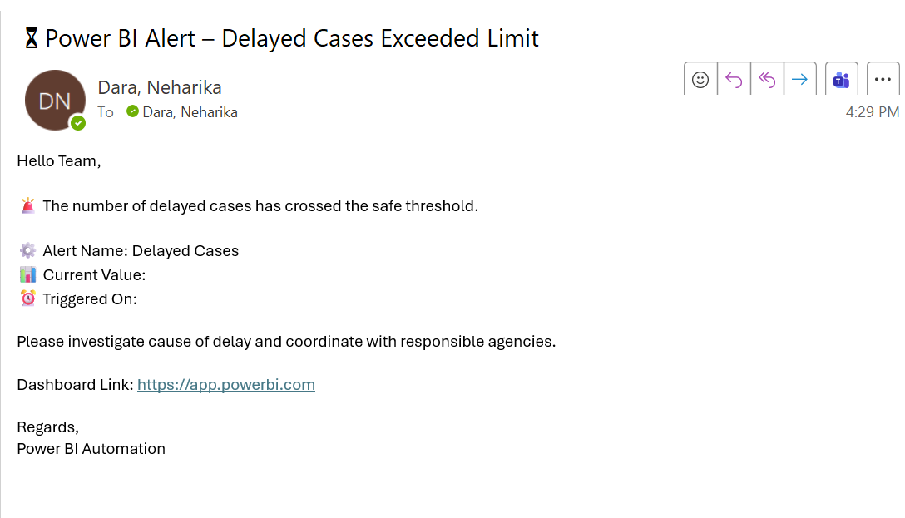
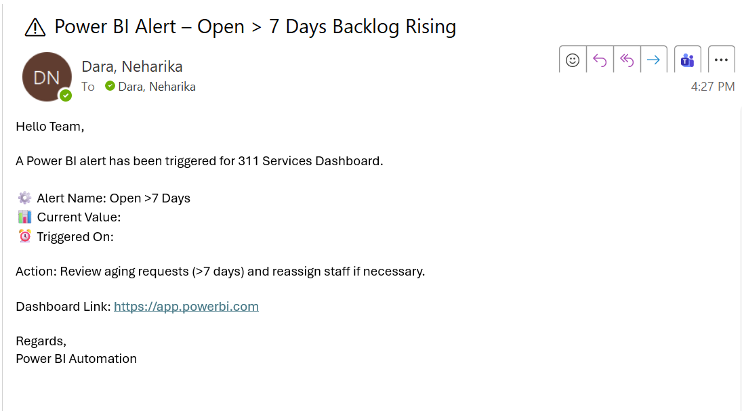
Alerts & Automation (Smart Features)
Objective:
To build a proactive monitoring system that automatically detects performance issues and notifies stakeholders without manual tracking.
Configured Alerts (in Power BI Service):
Open > 7 Days → triggers when backlog crosses 38,000 cases.
Sends an automated email via Power Automate.
Delayed Cases → notifies when delayed requests exceed 2,800.
Helps supervisors act on overdue issues quickly.
Avg Resolution Time > 5 Days → identifies slow performance trends.
Helps agencies monitor long-response tasks.
Automation Setup:
Used Power BI Data Alerts + Power Automate for real-time notifications.
Emails are automatically sent to supervisors when thresholds are breached.
Data refresh is scheduled daily to keep alerts up to date.
Impact:
Reduces manual tracking efforts.
Promotes faster issue resolution and accountability.
Supports Dabot.ai’s “AI + Automation” initiative for smarter city management.
Automation transforms the dashboard from a static report into a live monitoring system — enabling real-time insights and smarter decision-making.

Slide 6
Recommendations & Future Enhancements
Key Recommendations:
Prioritize High-Volume Categories:
Focus more resources on Street Cleaning and Homeless Concerns — they make up nearly 60% of total 311 requests.
Optimize Agency Workload:
DPW Ops Queue handles the largest share. Rebalancing staff or automating common tasks can improve turnaround.
Monitor Long-Resolution Agencies:
DPH Homeless Outreach and permitting-related requests require targeted support or multi-department coordination.
Use Alerts for Early Intervention:
The automated Power BI alerts help detect service delays before they grow into larger operational issues.
Impact Achieved:
Unified view of city service performance (150K+ cases analyzed).
Improved response monitoring via daily automated alerts.
Reduced manual workload through automation.
Foundation for predictive analytics and smart-city forecasting.
Future Enhancements:
Integrate real-time streaming data from APIs.
Add AI models to predict service demand and resolution delays.
Combine spatial clustering to identify “hotspot” neighbourhoods for quicker action.
This project demonstrates how data-driven decision making and automation can transform public service efficiency enabling smarter, faster, and more responsive city operations.

Slide 7

Thank you

